Slide 1
Requirement Traceability
By: Fariha Shaikh

Slide 2
What is Requirement Traceability:
is a project management tool in software development
used to track requirements and ensure that all parts of the software are built with the same quality and tested properly.
Each requirement describes how the software should work to meet a customer need and is linked to a specific part of the code.

Slide 3
For example, if a client asks for a login page to protect certain content, the requirement would be that the page blocks incorrect passwords and, when the correct password is entered, takes the user to the protected content.
Another Example: if a client requests a shopping cart for their e-commerce site, the requirement would be that the cart allows users to add or remove items, update quantities, and display the total price. When users proceed to checkout, the cart should transfer all selected items to the payment page accurately.
Another example: if a client wants a search feature on their website, the requirement would be that the search bar provides relevant results based on keywords entered by the user and displays those results quickly and accurately.

Slide 4
Requirements traceability is the ability to track a project’s requirements from start to finish. It links high-level project goals and deliverables to each specific requirement, following each one from its initial idea through development, testing, deployment, and any updates over time.
This tracking goes both forward (from requirement to final product) and backward (from product to original requirement), helping ensure every requirement is met accurately and any changes are effectively managed.

Slide 5
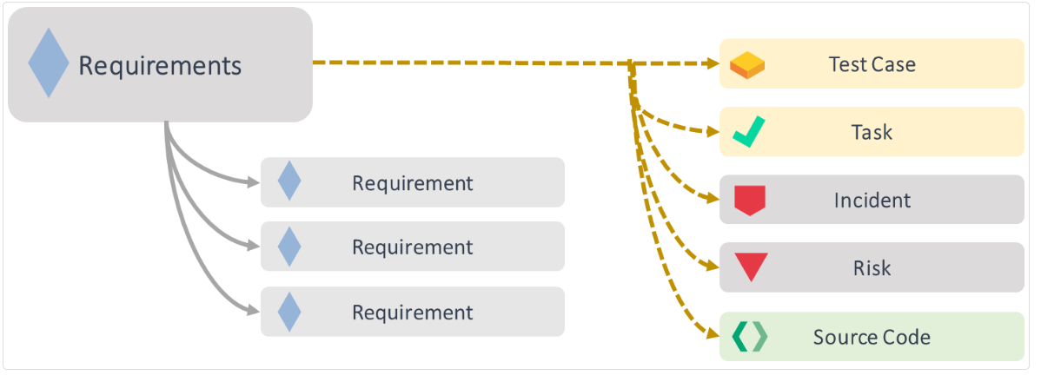

Slide 6
In requirements traceability, test cases, tasks, incidents, risks, and source code are all elements that can be linked to requirements.
Each plays a distinct role in ensuring the requirement is fully understood, implemented, verified, and managed throughout the project lifecycle. Here’s what each one means in this context:
Test Case:
A test case is a specific scenario or set of steps designed to verify that a requirement is correctly implemented.
In traceability, each test case is linked to a requirement to ensure it is tested for accuracy and completeness.
Example: For a login feature, a test case might check if users can log in with valid credentials.

Slide 7
2) Task:
A task is an action or a piece of work assigned to team members to fulfill a requirement.
Traceability allows linking tasks to requirements, ensuring that each requirement is being actively worked on.
Example: For a new feature, tasks might include design, coding, and integration.
3) Incident:
An incident is an unexpected issue or bug that arises during development or testing.
In traceability, incidents can be linked back to requirements to show which requirement is affected, aiding in impact analysis and prioritizing fixes.
Example: An error message appears when submitting a form, linked to a requirement for data validation.

Slide 8
4) Risk:
A risk is a potential issue that could negatively impact the project’s ability to meet a requirement.
Traceability helps identify which requirements might be at risk, allowing for proactive management.
Example: A risk might be a potential delay due to complex integration, linked to the overall requirement of system interoperability.
5) Source Code:
Source code is the actual written code that implements a requirement.
In traceability, specific parts of the code can be linked to individual requirements to ensure that the implementation aligns with what was intended.
Example: The code for the login authentication mechanism is directly tied to the requirement for user login functionality.

Slide 9
What is RTM & Why it is used?
is a table type document that links requirements throughout the project lifecycle, ensuring that each requirement is met and verified. It helps track each requirement from initial specifications through design, development, and testing phases. Also Known as Cross Reference Matrix.
It helps the testing team understand the testing level done for a given product. The traceability process is used to review the test cases defined for any requirement. Provides a structured format for tracking the status of each requirement and ensuring full coverage.

Slide 10
It ensures that project goals are met in a simplified way. The step-by-step process ensures the success of product testing.
It is prepared before the test execution process to make sure that every requirement is covered in the form of a Test case so that we don't miss out any testing.
The test engineer will prepare RTM for their respective assign modules, and then it will be sent to the Test Lead. The Test Lead will go repository to check whether the Test Case is there or not and finally Test Lead consolidate and prepare one necessary RTM document.

Slide 11
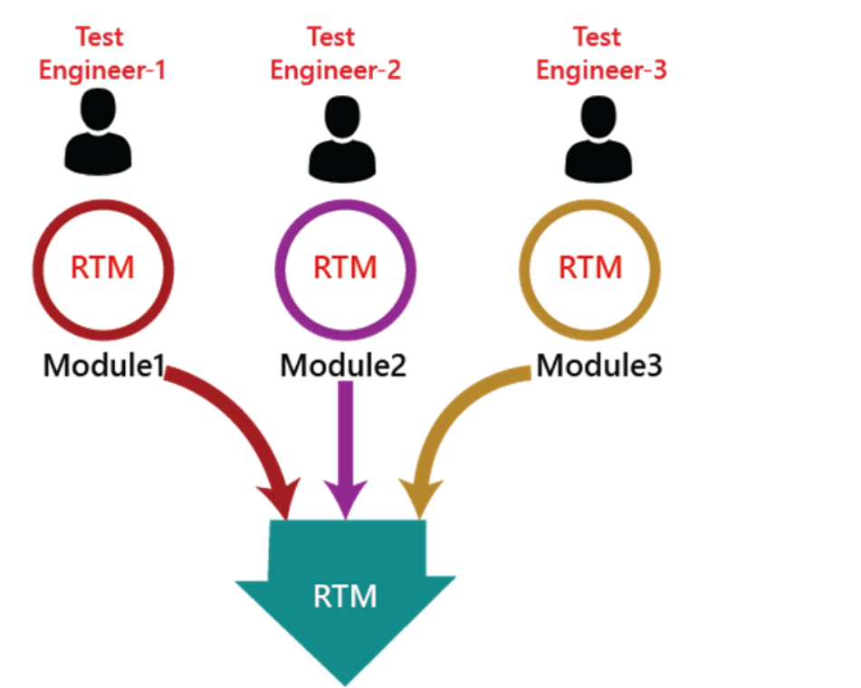

Slide 12
This document is designed to make sure that each requirement has a test case.
Test cases are created based on business needs provided by the client.
During testing, each requirement is checked through its test case.
If a requirement is missing from the document, it means no test case exists for it.
Any missing test case implies that the requirement was not tested, increasing the risk of undetected bugs.
The purpose of traceability is to ensure that all requirements are thoroughly covered and tested.

Slide 13
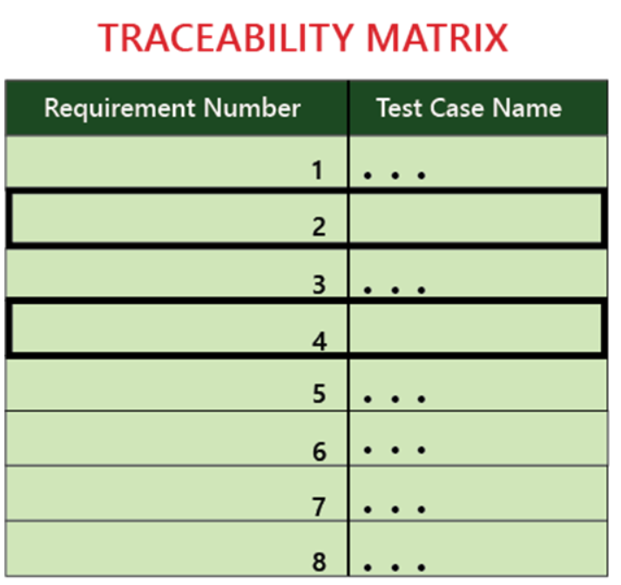
We can observe in the below image that the requirement number 2 and 4 test case names are not mentioned that's why we highlighted them, so that we can easily understand that we have to write the test case for them.

Slide 14
Forward Traceability:
Tracks the requirement from its origin through development, linking it to design documents, code, and test cases.
Ensures each requirement is implemented and validated through testing.
Backward Traceability (or Reverse Traceability):
Traces from the code or tests back to the original requirements.
Verifies that all developed features and tests are aligned with initial requirements, preventing scope creep or unnecessary additions.
Bidirectional Traceability:
Combines forward and backward traceability to provide a complete view of requirement implementation and verification.

Slide 15
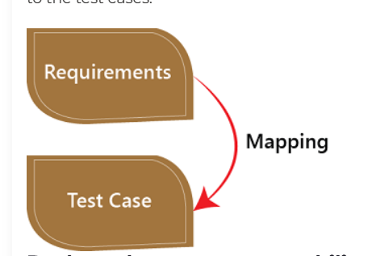
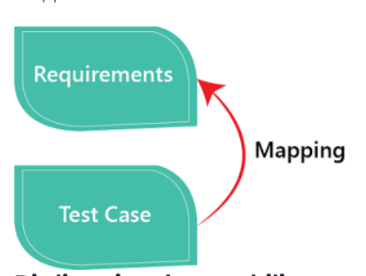
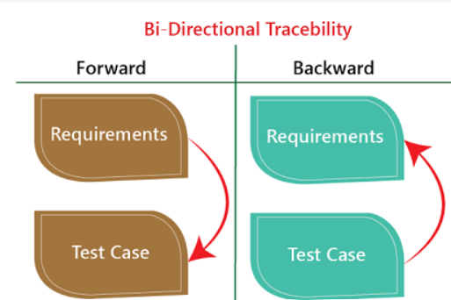

Slide 16
Ensures that each requirement is implemented in the code and has associated test cases, and that all code and tests are tied to an original requirement.
Useful for tracking changes and understanding the impact of modifications on requirements, code, and tests.
4) Requirement Attributes:
Additional details tied to each requirement, such as priority, status, version, and any changes over time.
Helps in managing requirements effectively, especially in complex projects with evolving needs.
In summary, requirements traceability helps ensure all requirements are addressed, all features have a purpose, and changes can be managed efficiently throughout the software lifecycle.

Slide 17
Parameters Of RTM:
The RTM typically includes the following key parameters:
1. Requirement ID: A unique identifier assigned to each requirement. It ensures that every requirement can be traced easily throughout the lifecycle.
2. Requirement Description: A brief description of the requirement. It outlines what needs to be accomplished, specifying the functionality or feature that must be implemented.
3. Source: The origin or source of the requirement, such as the stakeholder, client, legal regulation, or document (e.g., business requirement document, user stories, etc.).
4. Priority: The importance or urgency of the requirement. This can be classified as high, medium, or low, or it can be prioritized based on customer or business needs.

Slide 18
5. Design/Implementation: This column links the requirement to the design or implementation phase. It can include references to specific design documents, modules, or code components that implement the requirement.
6. Test Cases: A reference to test cases or test scripts that verify the requirement. This ensures that each requirement has corresponding tests to confirm that it’s working as expected.
7. Test Status: The status of the tests for the requirement, such as Passed, Failed, Not Tested, or Pending. It helps track the progress of testing activities related to the requirement.

Slide 19
8. Traceability: Links to both forward and backward traceability. Forward traceability shows how the requirement has been translated into design, code, and testing, while backward traceability shows how the requirement aligns with the original business needs or objectives.
9. Defects or Issues: Any defects or issues found related to a requirement during development or testing. This helps identify if a requirement has been met or if it needs further attention.
10. Status: The current status of the requirement in the project lifecycle (e.g., Not Started, In Progress, Completed, Implemented, Validated, etc.).

Slide 20
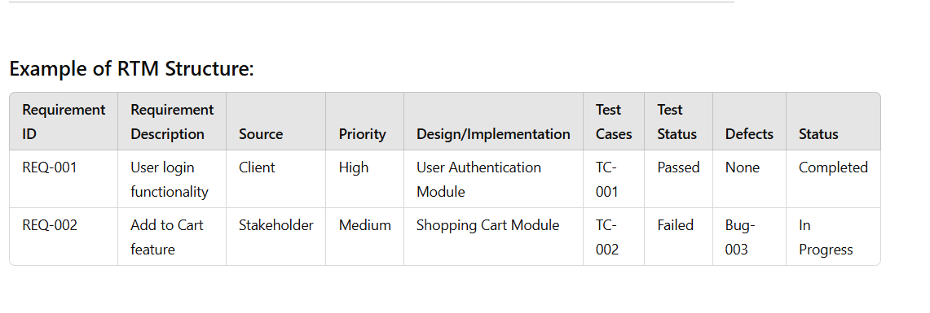

Slide 21
Requirements traceability best practices:
Define Clear and Detailed Requirements: Ensure all requirements are clearly defined, measurable, and testable. This makes it easier to trace them through the development lifecycle.
Use Traceability Tools: Use requirements management or traceability tools (such as JIRA, IBM DOORS, or TFS) to document, link, and track requirements.
It help to maintain relationships between requirements, design, code, and tests efficiently.
Maintain a Requirements Traceability Matrix (RTM): Create and update an RTM to track the status of each requirement. Regularly review and update the RTM throughout the project to ensure it reflects the current status.

Slide 22
4) Align Requirements with Business Goals: Ensure all requirements are aligned with the business objectives and stakeholder needs. This helps prioritize which requirements are critical and which can be adjusted or removed.
5) Track Changes and Updates: Requirements often evolve, so it's crucial to track any changes in requirements and their impact on design, development, and testing.
6) Involve Stakeholders: Collaborate with stakeholders to ensure that requirements are correctly understood and interpreted. And validate the traceability matrix to ensure it accurately reflects the requirements and the corresponding work.
7) Continuous Verification: Continuously verify that all requirements are covered in testing and that test cases are linked to specific requirements.
8) Clear Documentation: Ensure that all traceability documents (RTM, test cases, design specifications, etc.) are well-documented and easy to understand. This facilitates communication between team members and stakeholders.

